Slide 1
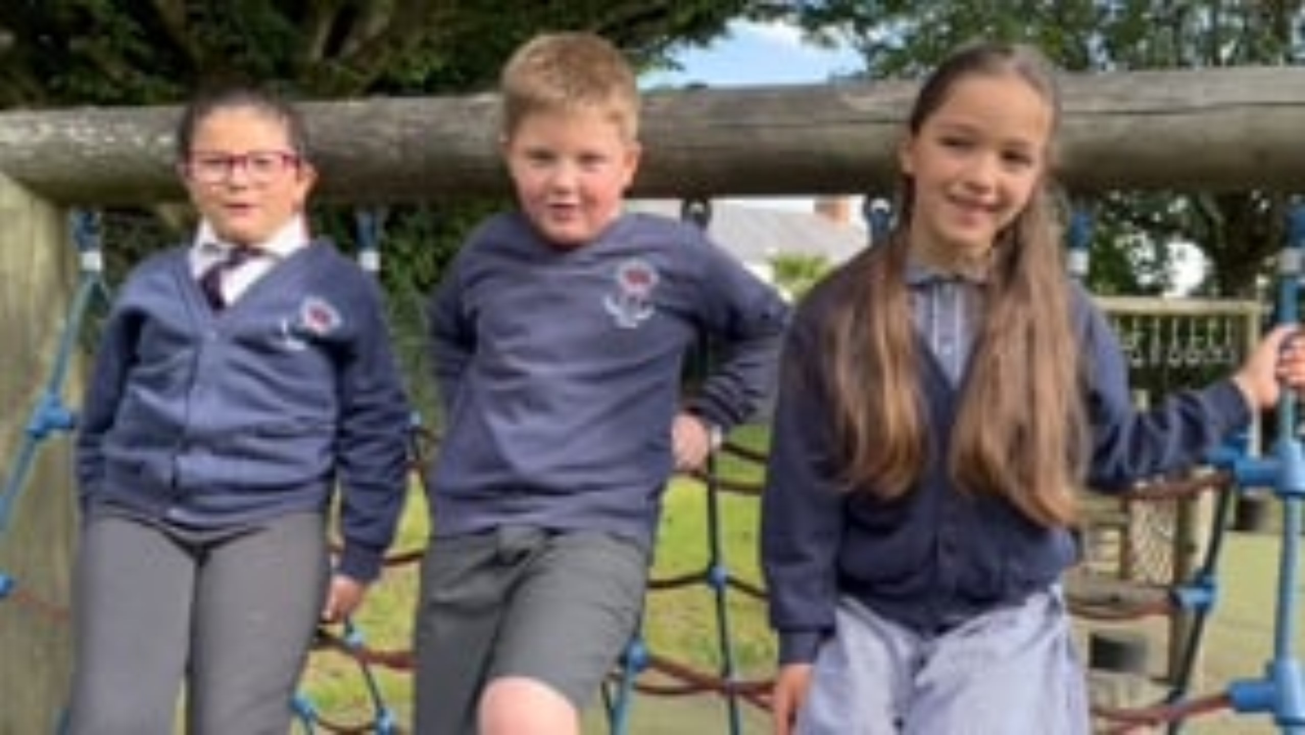
Welcome to
Manor Court Community
Primary School

Slide 2
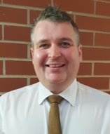
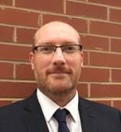
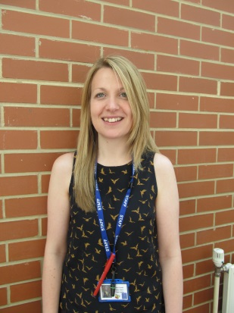
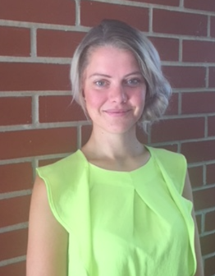

Our Staff
Mr Talmage
Mr Clode
Mrs Farwell
Miss Gregory

Slide 3
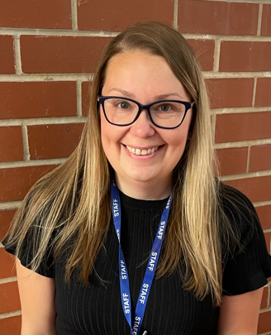
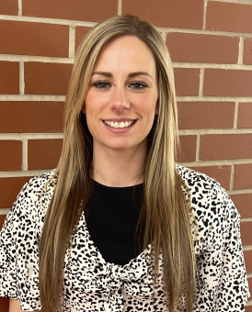
Our Staff
Miss Hamilton (Squirrels)
Miss Grabham (Hedgehogs)

Slide 4
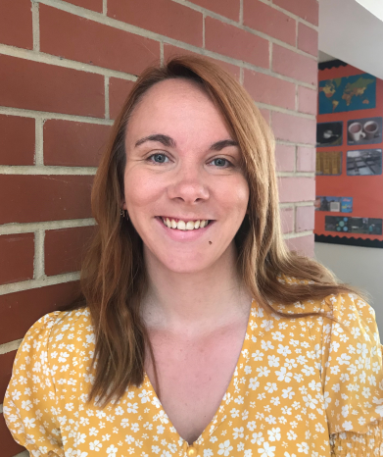
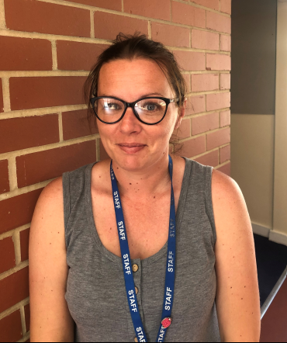
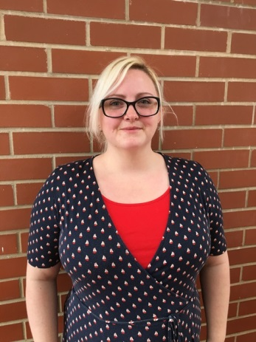

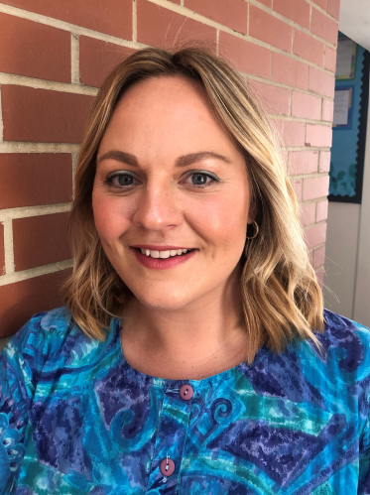
Support staff
Miss Harris
Mrs Murphy
Mrs Birks
Miss Behan
Mrs Lane

Slide 5
Helping your child to be ‘school ready’
Reading, reading, reading!
Physical activities such as play dough, using pegs, painting etc. to support writing.
Writing their name.
Counting and recognising numbers.
Helping your child with their reading, writing and counting is
important, but there are other skills that are just as important in school…

Slide 6
Independence. Encourage children to dress and undress independently, use a knife and fork, open their own lunchbox and go to the toilet independently. Ensure clothes are easy to do up and shoes are slip on or velcro. Ties on elastic.
Social skills. Talk about feelings and how to share. Practice taking turns, and let them know that it’s ok if they don’t always win!
Perseverance. If at first you don’t succeed, try, try again!

Slide 7
School Day
Children start school on Wednesday 4th September. School starts at 8.40 each day. Please enter via top gates due to work on playground drop off outside the Foundation gates and come in.
CHANGE TO TIMETABLE: Collection will be 12.30pm for the first two weeks. Please come to top gate and you will be let in and escorted.
On Monday September 16th Children will start full and be collected at 3.15pm. Please still use top gate.
Please drop and collect your child outside the Foundation Stage fence, please do not come into the classrooms to collect to prevent any confusion. Parents, children and siblings are not allowed to play in the Foundation area before or after school.
Please inform us if someone else is picking up your child from school. You can bring them in to introduce to the team or even bring in a photo to help make sure your child remains safe. We will not let your child home with someone who does not have permission.

Slide 8
Snack Time
A variety of fruit snack and bagels are provided.
Please provide children with a NAMED bottle of water.
Please do not provide own snack.

Slide 9
Lunch Time
Children will start having lunches from 4th September.
Lunches are available to all.
Menus for Sept are available - please complete today and return to Mrs Glentworth.
We are lucky enough to have had a new kitchen installed. Meals are now cooked fresh on site.

Slide 10
Lunch Time
Children will have their lunch in the hall.
We will let you know if your child is eating less than half of their meal.
Make sure that names are on all items, lunchboxes and flasks/lids
Teachers will stay with the children initially until they are settled.

Slide 11
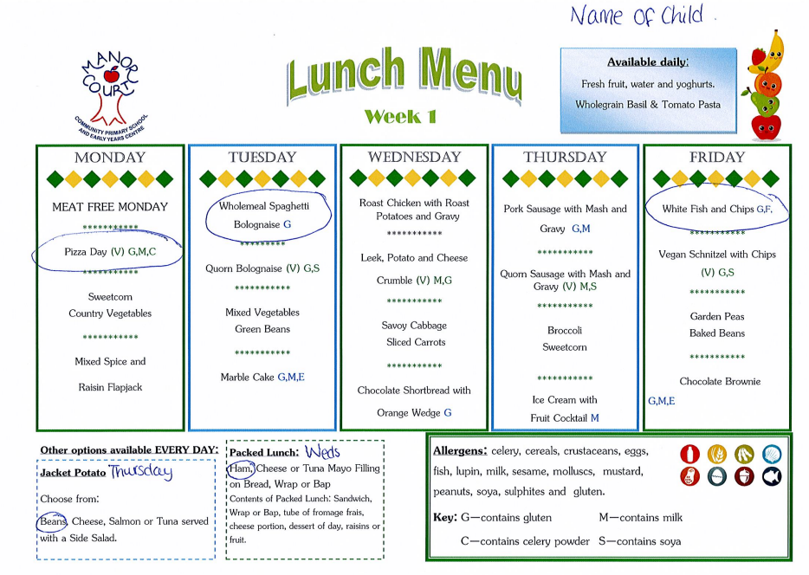
Lunch Time

Slide 12
How we learn
In Foundation Stage children spend a lot of their time learning through play, along with a range of adult led activities.
Manor Court School fosters a love of learning and encourages children to learn through practical experiences. This includes the Manor Court 48 which gives the children a new and exciting experience each half term. In Foundation Stage the children will experience:
Mud Slide
Perform a play to an audience
3. Eat something you have made yourself
4. Looking after animals
5. Cooking
6.Facepaints

Slide 13
Homework
Children will receive phonics letter formation homework from their third week of school. We also send home sharing books for you to read with your child.
When we send home words to read and reading books for your child we will ask for you to hear them read 5 times a week and record this is their reading record.
A practical homework activity will be sent through email on Eylog every other week and parents are asked to upload a photo of their child completing it to be shared in class.
Weekly spellings will be introduced after Christmas

Slide 14
EyLog
Eylog is a brilliant online learning journey that allows school to upload observations using photos, videos and comments about children’s learning and instantly share them with parents. Parents can also upload their own observations and share them with their child’s teacher.
Your child’s teacher will use these observations to support your child’s learning and find their next steps. It is also a lovely way to prompt conversations both at home and at school about what your child has been doing and what their interests are.
Eylog also has a message feature that allows your child’s teacher to share information with you and for to message your child’s teacher.
We aim to reply within 24 hours to any messages so for any thing urgent please speak to your child's teacher before or after school or contact the office.

Slide 15
EyLog
You can add picture and video observations and that is a lovely way for us to build a relationship with the children and prompts conversation.
We use Eylog to send you homework tasks and regular curriculum updates.
This year we will be activating your Eylog account before the start of the summer holidays. This will allow you to upload photos of your child’s interests and achievements over the summer holidays to help us get to know your child before they start school.

Slide 16
Parent Pay
Letters, consent forms, payments and lunch menus will all be sent through ParentPay.
Please ensure you are signed up to this as soon as we provide the details for you.
If you have a child in EYC your account will be transferred
If you already have a child in the school you will have to use the details we provide to add your FS child.

Slide 17
Wrap around care and clubs
Wrap around care is provided before and after school. More details about this is available from Mrs Hooper including times and prices.
A range of clubs will be available after school after Christmas.

Slide 18
Uniform
Manor Court Primary School uniform can be purchased from Barrons.
Cardigans and jumpers must have the Manor Court logo. Tie must be worn (not with summer dresses)
PE kits – daps, shorts and plain coloured t-shirt or logo t shirt. You will be told your child’s PE day and they can wear the kit all day.
Please make sure that all clothes and shoes have names in, we will put names in if none can be found.
No jewellery permitted. Plain stud earrings – these will need to be taped for P.E.
Shoes only – not sandals, boots or trainers.
Please tuck shirts in.

Slide 19
Allergies
Please make any allergies known to us and also on your child’s data sheet located in the office (including plasters).
Inhalers will need to be named and given to reception to allow them to fill in relevant forms and pass on to class teachers.

Slide 20
Medicines
If your child needs medicine for any reason please take this to the school office and complete the relevant forms.
Sun Safety
In warm weather please apply sun cream before your child comes to school and send them in in a named hat.
If you would like your child to re-apply sun cream please put a named bottle in their bag. We can not apply it for them but will support them to do it themselves.

Slide 21
FMCA
The Friends of Manor Court Association
Parent Volunteers who work closely with MC staff to raise funds for the school.
Meet once a term to discuss fundraising and equipment the school needs
Hold events such as discos, summer fete and competitions
Contact then directly by email if interested
contactfmca@gmail.com

Slide 22
Parking
As the car park is quite small it is for staff only. However, parking permits are available to park in Sainsbury's or Crowshute.
Application information has been sent and are available from the office.

Slide 23
Follow us!
Facebook – Manor Court Community Primary School
Twitter - @ManorCourtChard
Letters, calendar dates and lots of other information is available from our website.
https://www.manorcourtcommunityprimary.co.uk/

Slide 24
And Finally….
We feel that the partnership between home and school is essential to support your child achieve their full potential. We encourage open communication and believe that nothing is too trivial , we are always happy to talk with families and will support you as much as possible.

